Slide 1
Big data analytics in the Medical domain
Huiran Liu
Roxana Tapia
Oliver Budke

Slide 2
Agenda
Project objectives (Oliver)
Medical background (Oliver)
Glossary of Terms
Influences on ABP
Implementation / Technology
Workflow and Architecture (Huiran)
Prediction model with Python (Huiran)
Flink API (Roxana)
Windows (e.g. moving average functions)
Live Demo for AHE patient / current progress (Roxana)
Visualisation of AHE using Grafana
Next steps (Roxana)
Discussion / questions (Oliver) 30:00

Slide 3
Advantages of Healthcare Analytics Data
Doctors can speed decisions based on results
Exchange of medical information
Identification and Prediction of diseases
E.g. UIMA
Initial stage disease detection
Datasize: prediction of yottabytes (10^24) in large populations

Slide 4
Challenges of Big Data in Health
different types of
structured,
semi-structured
and not structured at all data
4 V
Data generation:
Mobile technology
Cloud Services
Social Technologies
Big Data Analytics
Electronic Health Records (structured)
Semantic processing
Surrogate dates

Slide 5
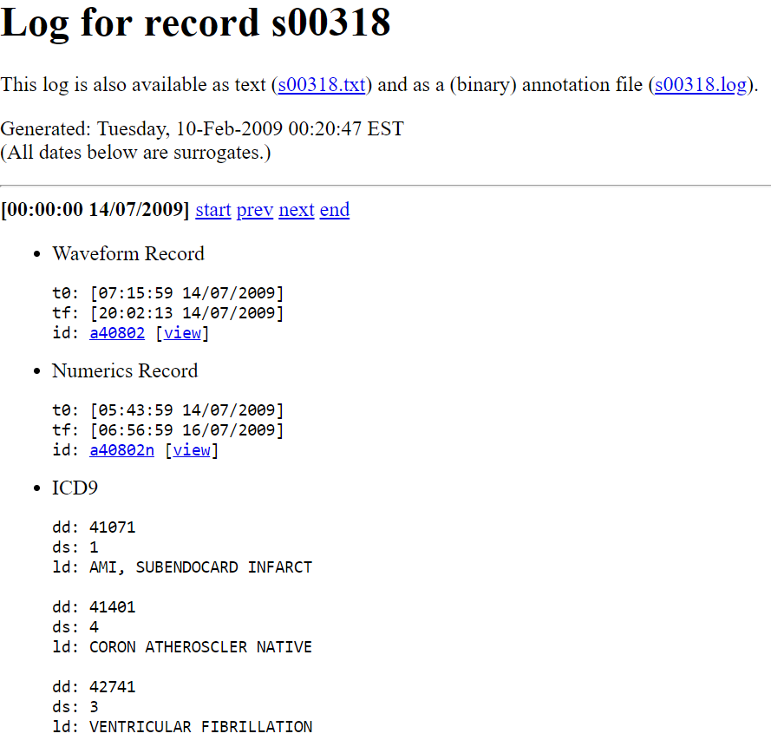
Training Set
60 records
use information available before T0 to predict if the patient will have an acute hypotensive episode
AHE begins midway through the forecast window, about 30 minutes after T0
PhysioNet / Cinc Challenge 2009: MIMIC II Clinical Database
Subject name
MIMIC II Waveform record
Numeric records name
T0
Sex
Age
set of plots illustrating mean ABP (= Arterial Blood Pressure)

Slide 6
Influences of Human Behaviour
Physical Actions
Observable Emotions
Social Interaction Patterns
Temperament
Climate Change
Air Pollution
Medical Issues
Understand desease development

Slide 7
Technology Stack
Java
GitLab
Flink
Etc.

